Slide 1

Session 05
DataView And DataGridView - Data Binding

Slide 2
Review
ADO.NET Architecture
.NET Data Providers
Data Access Components
Connection object
Command object
DataAdapter object
DataReader object
DataSet object
DataProviders

Slide 3
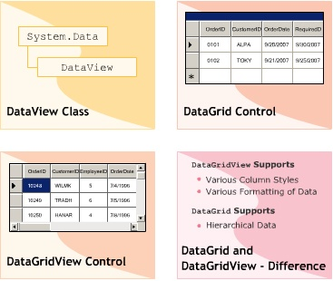
Objectives 1
DataView Class
DataGrid Control
DataGridView Control
DataGrid and DataGridView - Difference

Slide 4
“DataView” Class
The DataView class is used to sort, filter, search, modify, and navigate through the records of a table. This is done by taking the DataTable object as the parameter in the constructor of the class.
Syntax
DataView <objectname>=new DataView(<DataTable>);

Slide 5
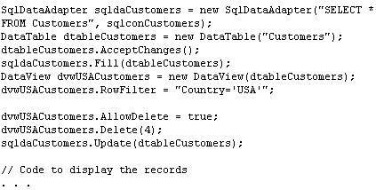
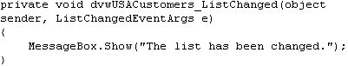
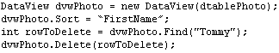
Events and Example

Slide 6
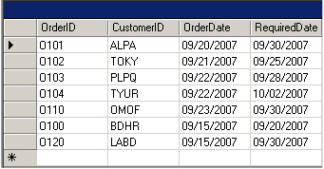
“DataGrid” Control
The DataGrid control displays data in tabular format. It acts as an interface for DataSet objects and is used to display the data of the required table from database.

Slide 7
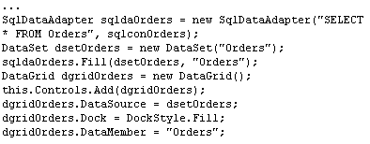
Example DataGrid control

Slide 8
“DataGridView” Class
The DataGridView control is a flexible control used to display dadta from a talbe in a tabular format from different types of data sources.
Features of datagridview
Provides different column styles such as columns with Textbox and Checkbox..
Supports multiple datda sources to work with different databases.
Implements the virtual mode feature by allowing the control to use the cache memory.
Uses the BindingSource component to simplify the process of data binding.

Slide 9
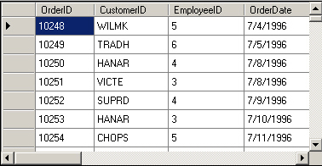
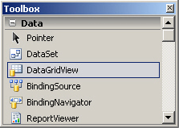
Using
The DataGridView class is new in .NET 2.0
Displaying small amount of data using the unbound mode.
Viewing and updating data in tables of a database using ADO.NET object such as DataTable.
Handling large amount of data using virtual mode for optimum performance
Customizing the rows, columns, cells, and headers to provide tooltips and shortcut menus.

Slide 10
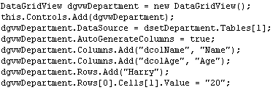
Example 1

Slide 11
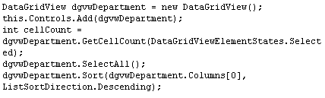
Example 2

Slide 12
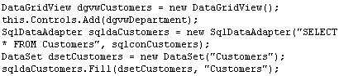
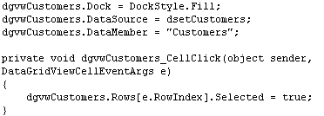
Example 3

Slide 13
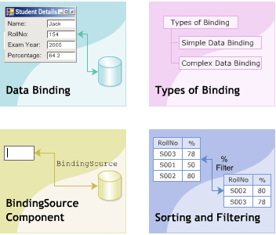
Objectives 2
Data Binding
Types Binding
BindingSource Component
Sorting and Filtering

Slide 14
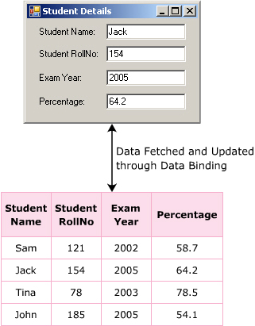
Introduction to Data Binding
Data binding is one of the most powerful features of .NET and Windows Form. It helps in linking a control to a data source such as tables in the database. This is useful to view, insert, udpate, search, and delete record in the table.

Slide 15
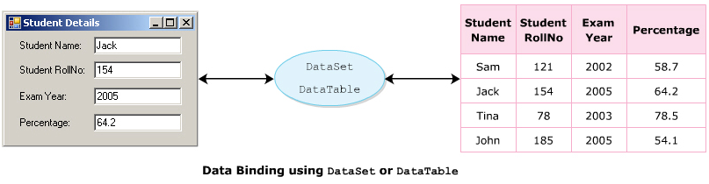
Process of Data Binding
Data binding allows you to create a link between the controls of the form and the database. You can fetch records either from a single table or multiple tables.

Slide 16
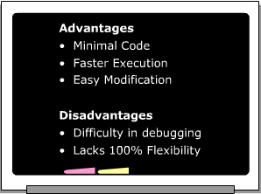
Advantages and Disadvantages

Slide 17
“BindingContext” and “CurrencyManager” Classes
Windows Form contains at least one BindingContext object. This object is an instance of the BindingContext class, which helps in binding to multiple data sources. For any control that inherits from Control class, the BindingContext object manages a collection of BindingManagerBase objects. These objects are instances of the BindingManagerBase class. It helps in managing all objects bound to the same data source.
All data sources, which are bound to Windows Forms controls, will be linked with a currency manager. The CurrencyManager class used to implement currency manager and used point to an item in the data source. It has a one-to-one relationship with data source and is used to navigate through records

Slide 18
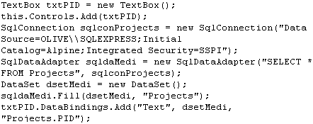
“BindingContext” class
The BindingContext class defines various properties, methods, and events used to specify and retrieve items and bound objects.

Slide 19
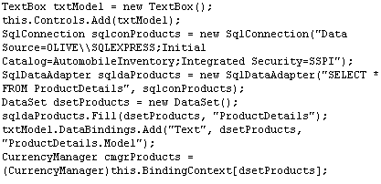
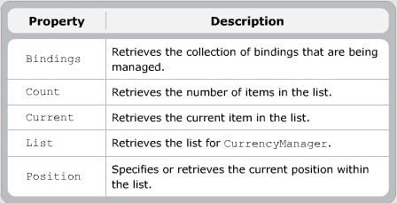
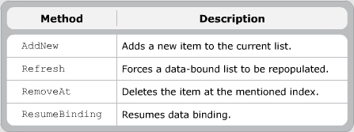
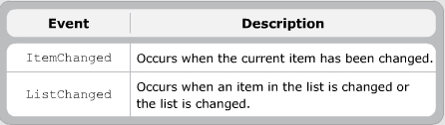
“CurrencyManager” Class
If two textboxes refer to two different fields of the same table called Student. The CurrencyManager class ensures that the correct values are displayed in the respective text boxes by using the various properties, methods and events

Slide 20
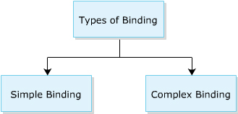
Types of Binding

Slide 21
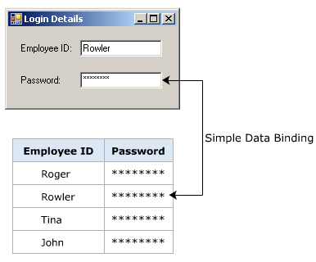
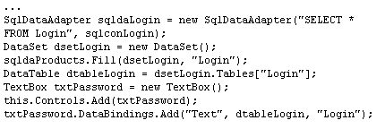
Simple Data Binding
Simple data binding is the ability to bind a control to a single value in a data source. This type of binding is basically used for controls such as TextBox or Label because they only display a single value at the time.

Slide 22
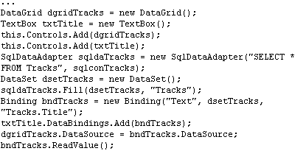
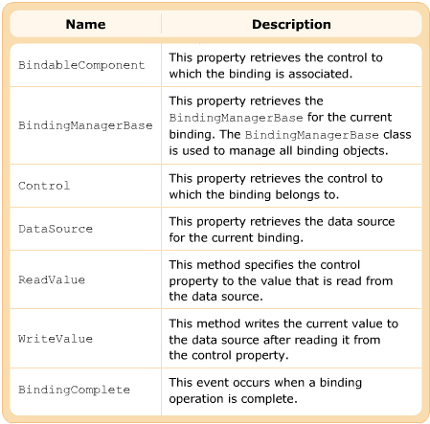
“Binding” Class
The Binding class helps to bind the property value of an object to the property value of a control.

Slide 23
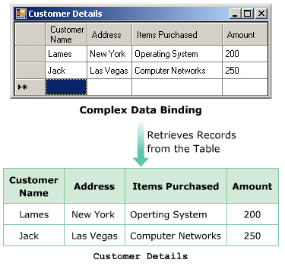
Complex Data Binding
Complex data binding allows you to bind the control to multiple data elements. By using complex data binding, a DataGridView can be bound to an entire DataSet. Some of the controls that support complex binding are DataGrid, ComboBox, ListBox, and ErrorProvider controls.

Slide 24
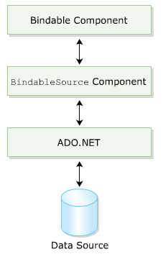
“BindingSource” Component
The BindingSource component is a new component introduced in VS 2005 to simplify the process of data binding. It acts as a data source for controls by adding data to it and finally updating the database. It also acts as a medium to provide binding and currency management functions.
Features
It acts as a strongly typed data source.
It helps in binding the controls and data indirectly
It supports data navigation, data manipulation, and sorting and filtering of data.

Slide 25
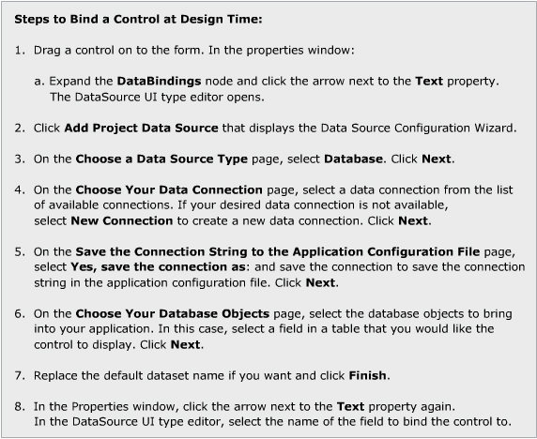
Properties of “BindingSource” class

Slide 26
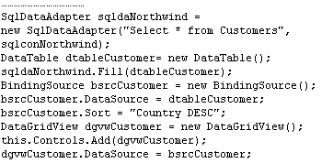
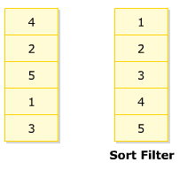
“Sort” Property
The Sort property of BindingSource class is used to retrieve or specify the names of the column used for sorting, and also the order in which data is sorted. This property is new in .NET 2.0

Slide 27
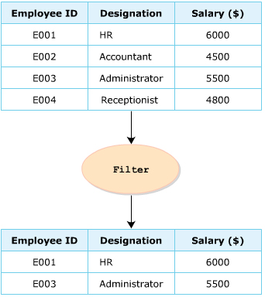
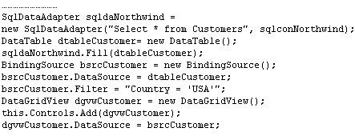
“Filter” Property
The Filter property of the BindingSource class is used to specify or retrieve the expression, which is used to filter the record. This property is new in .NET 2.0

Slide 28
Summary and Workshop
DataView Class
DataGrid Control
DataGridView Control
DataGrid and DataGridView – Difference
Data Binding
Types Binding
BindingSource Component
Sorting and Filtering

Slide 29

THANKS FOR WATCHING !

